Slide 1
Dexter Application
DB Hackathon 2021
MindBenders

Slide 2
Background
Today everyone is moving toward digitalization
One of the important thing we use now-a-days a digital payment method instead of banknotes.
E.g Google pay, amazon pay, paytm etc.
None of them have support or way to make payment for people who have difficulty to view things.

Slide 3
GCP Features
Deployment: App Engine
Version Control: Google Source Repositories
Google Cloud SDK

Slide 4
Dexter Application
Digital Assistant :Dexter.
URL:
https://dexter-app-dot-hack-mindbenders.an.r.appspot.com
It will be layer on top of any digital payment gateway.
It is an interactive way of making payment which uses voice as a medium to communicate with the user.

Slide 5
Additional security
Along with the security questions mode showed in the video, we can have additional following security to be implemented in the app
Not allowing transaction of more than 2000 rupees.
Adding fingerprint scanner as an addition security layer.
Analysing and monitoring the transaction pattern for that specific user using GCP AI/ML services and restricting any transaction which does not follow that specific pattern.

Slide 6
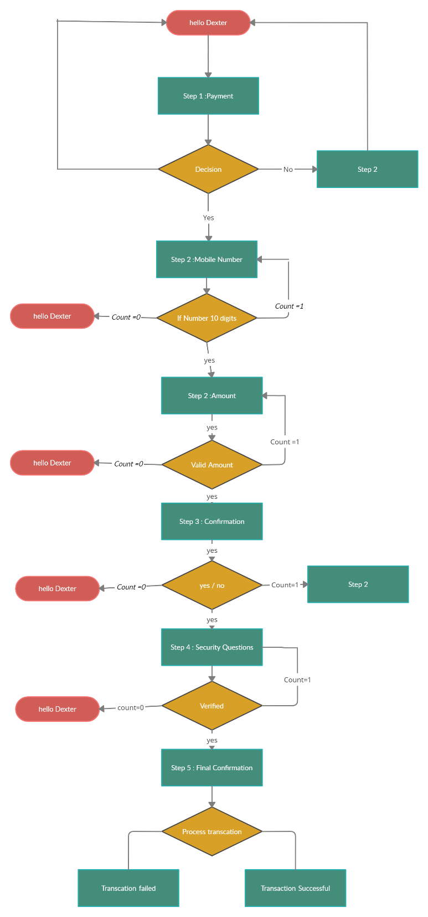
Dexter Flowchart

Slide 7
Thanks all…
Let us know your feedback.

